Slide 1
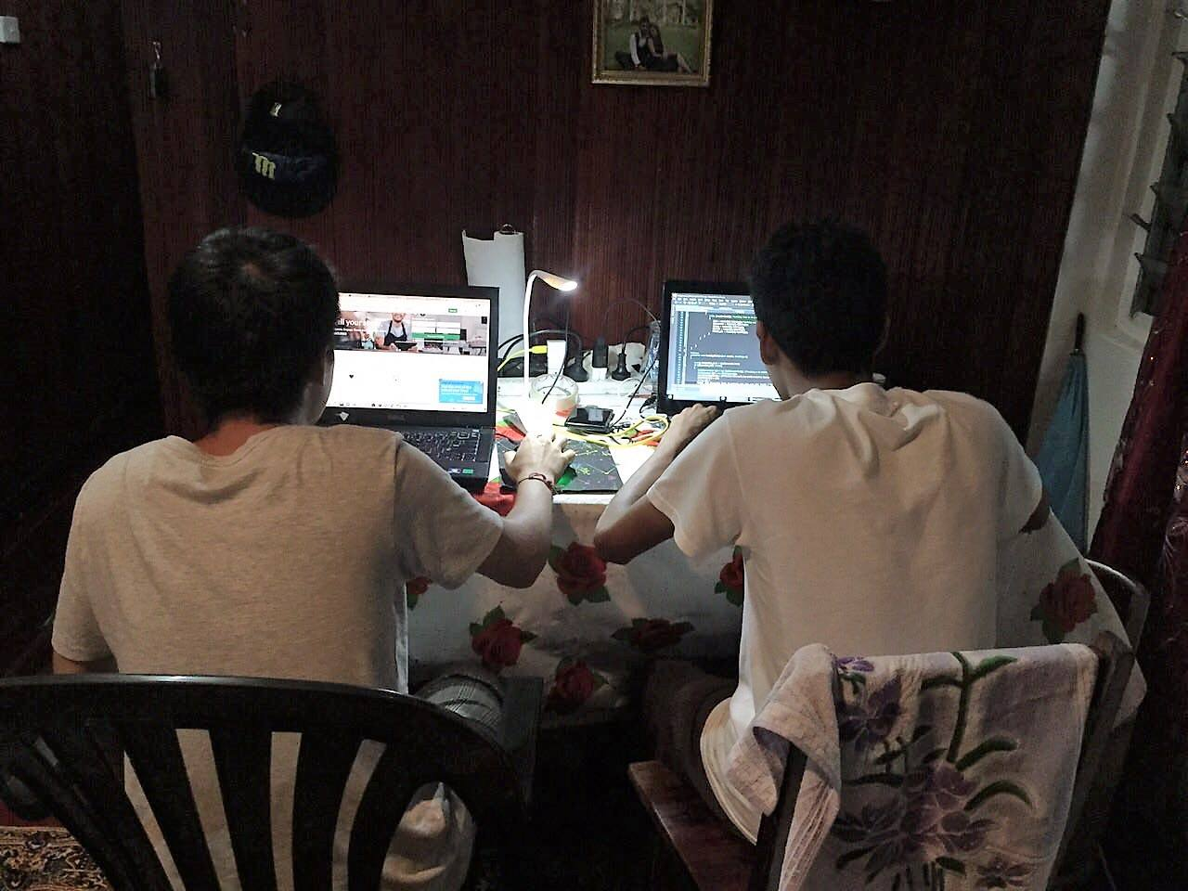
IS221:Assignment 2 Group:74
Student ID: S11110926-Kunal singh, S11120129-Vincent huang.

Slide 2
Introduction
The Project option we chose to do was on a Music Band which we named
Nuclear-Popsicle
Nuclear-Popsicle’s mission is to create, provide and bring magical life-changing experiences through Nuclear-Popsicle’s Music.

Slide 3
Content Goals
This website can be a public interest website The reason we have chosen this is as a public interest website is because our client is interested in promoting his band to the general public.
The content goal of this website is to provide amusement and enjoyment to anyone who visits the website.

Slide 4
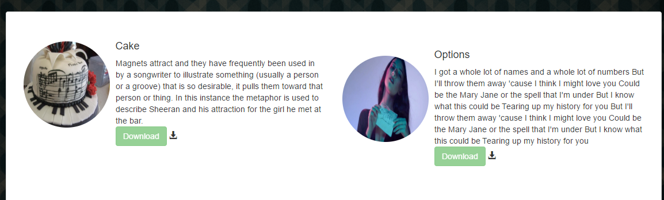
Content Goal-Demo
The above picture demonstrates a feature from the Web Application.

Slide 5
Audience
The Targeted Audience for this website are for people who have passion for music regardless of the age, nationality and gender. Since Nuclear-Popsicle composes music for all types of audiences

Slide 6
Site Content and Functional Requirement
Dynamic Search: Users are able to Search for Music
Music Player: user can Listen to Music
Downloading of music: users are able to Download Music
Interactive Discussion Forum: users have the capability of Sharing their Thoughts

Slide 7
List of Web-Pages
Home: Shows The Latest Content Home
News this is Sub-divided into Two Categories which are Latest and Trending News Music: enables users to Download and view the latest Releases.
Trending-News/Latest-News
Discussion Forum: Users has the Capability to share their opinions and receive comments. Discussion
About-Us Contact-Us
Search: this is shown through out the web-page for users to search for music's
Admin-Panel: this page is for the admin to add/remove content.
Login page: this enables the user to download music and post Discussion.Login
Recover Password: if users have Forgotten their password

Slide 8
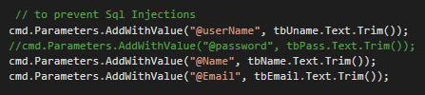
Security
This website is not prone to SQL injections since we are using ASP.Net Framwork’s inbuilt functions to prevent such threats

Slide 9
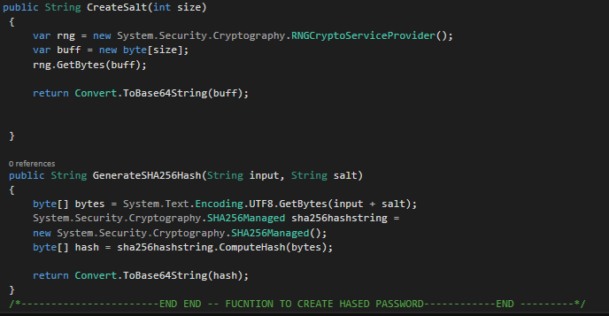
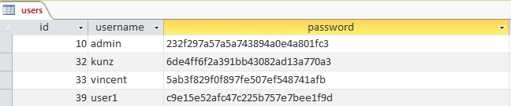
Security
This Web-App uses salting encryption techniques to store password in the Database

Slide 10
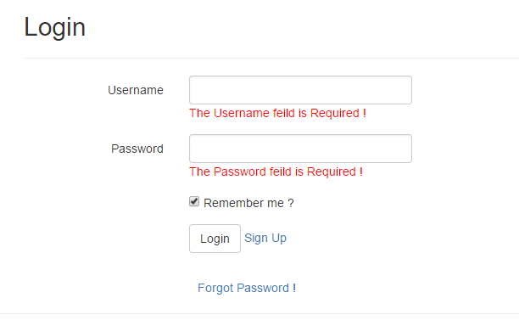
Login page-Explanation
Login Page
Has Two options:

Slide 11
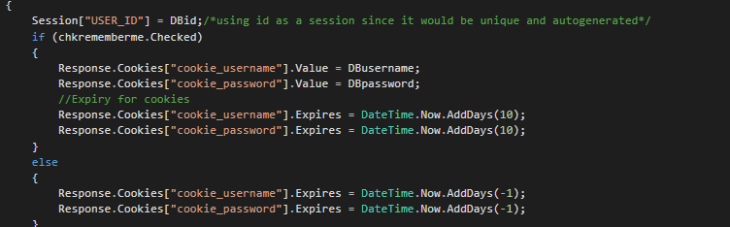
Login page-Explanation
We are using Sessions to store users login information which is unique to all users(ID AI)
We have also made use of Cookies (by clicking Remember me checkbox) so that users don’t have to Log in every single time.

Slide 12
Site Navigation
It is easy for users to know where they are since the menu bar would be highlighted accordance to the page they are in

Slide 13
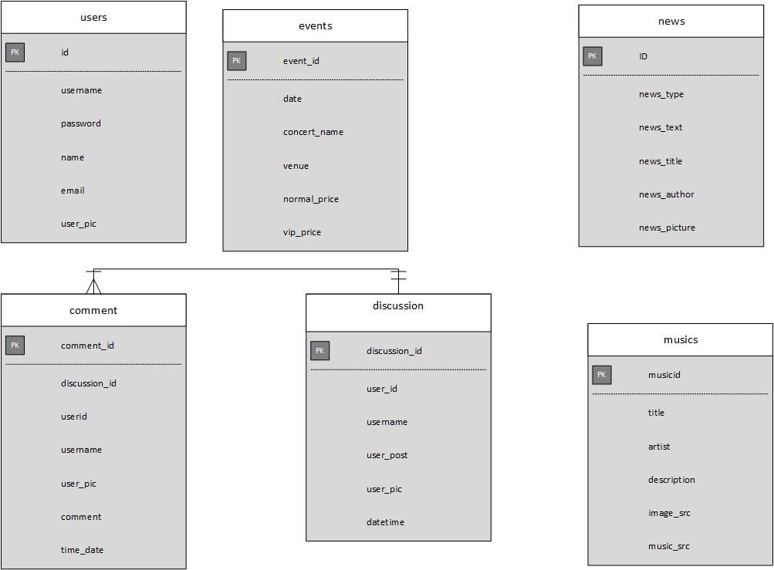
Database Tables

Slide 14

Video

Slide 15

Questions

Slide 16

The End
Bring you the Best Tunes

